Slide 1
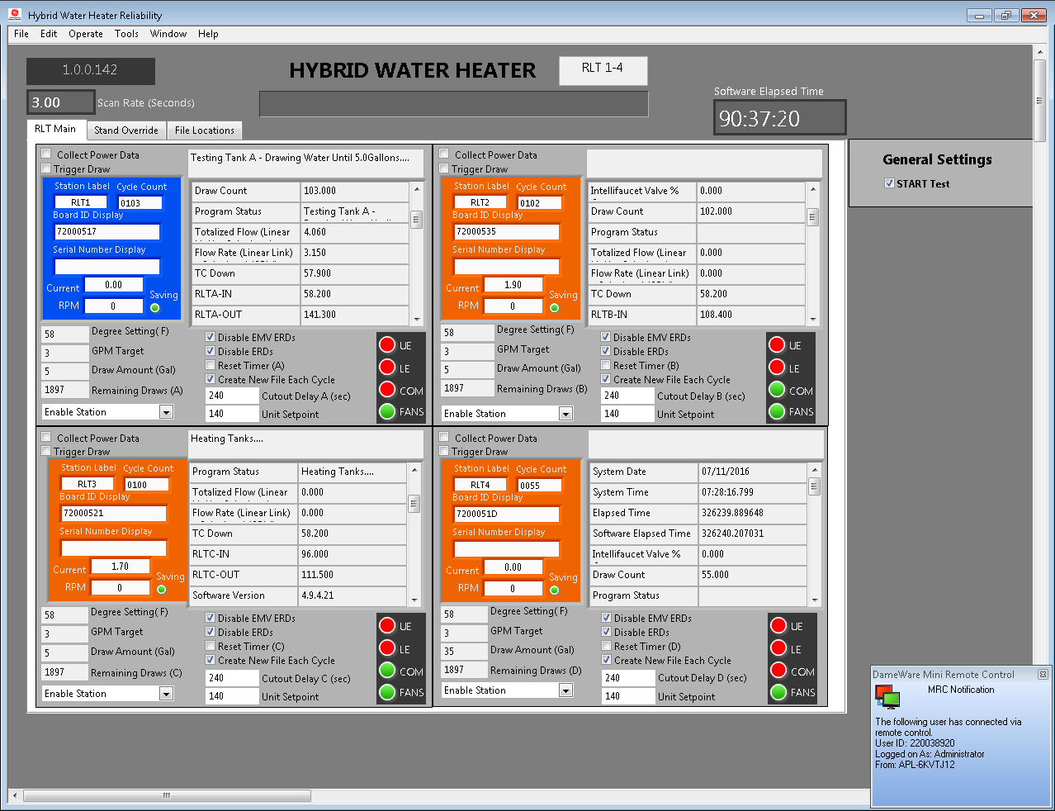
This is a button to enter the test setup screen
You can run 1-4 stations . Its setup to run on a variety of equipment. We run Reliability Test (RLT), Production Reliability (PRAT), and Standard Development. Each station type has slightly different equipment

Slide 2
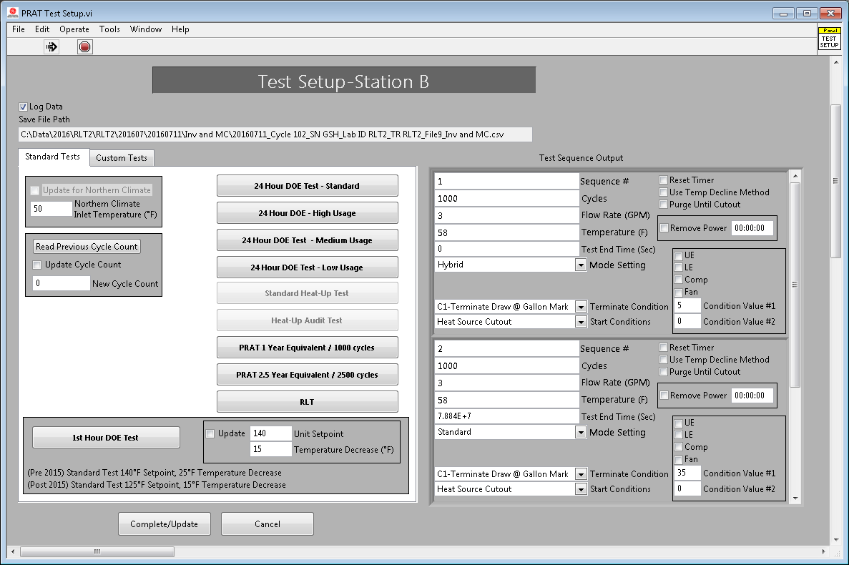
You can load a custom test from file (I am still working on this)
Click Log to File…it will take you through a series of screens to write data (Creates Files, Folders, and checks calibration
All stations (regardless of equipment selection can run the same tests..These are standard tests)
If you need to modify a standard test…you can modify here

Slide 3
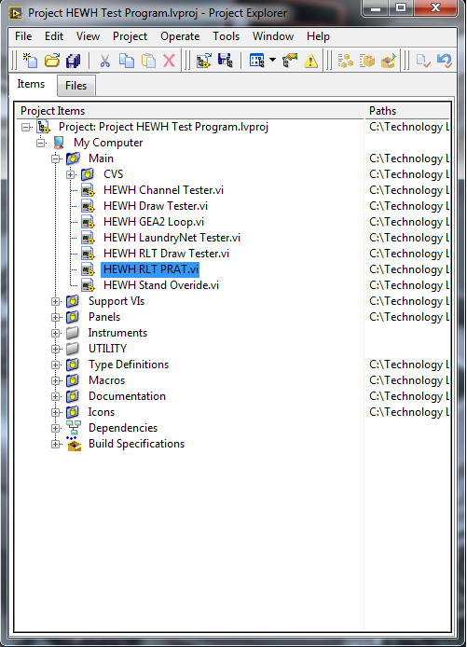
When you open the main project….you will need this one. I am trying to obsolete the others

